Slide 1
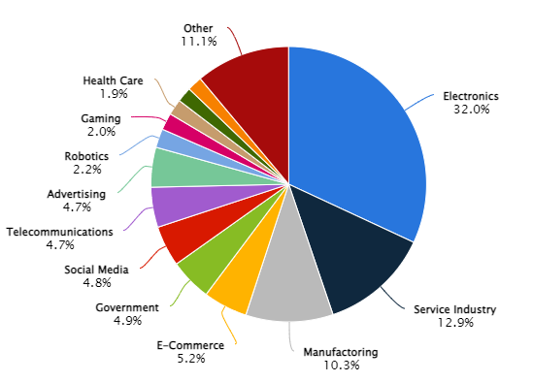
Potential Market
AR VR
Wearable devices
Robotics and Teleoperation
Automotive
Defence and Military training
Gaming and Entertainment
Medical and Healthcare
Industrial Training

Slide 2
Problems in market
Unavailability of a single device that integrates the purpose of many devices
Cost and Affordability
Absence of India-Based manufacturer
Limited Customization for Local Needs
Dependence on Imports and Higher costs
Slower Market Penetration:
International companies might prioritize larger or more established markets over India.
Limited After-Sales Support and Maintenance
Lack of Trust on reliability and effectiveness of the product
Lack of awareness and usage in commercial market

Slide 3
Drawbacks of existing product
Cost
VR gloves can be expensive, costing thousands of dollars. They may also require additional licenses or subscriptions.
Weight and bulk
VR gloves can be heavy and bulky, which can be distracting.
Tethering
Some VR gloves may need to be connected to a power source, such as an air compressor, or may require cables.
Difficulty of use
VR gloves may be hard to put on or take off, especially for people with limited hand mobility.
Inaccuracy
The design of VR gloves can involve external attachments that can degrade over time and cause inaccuracies.

Slide 4
Cost – Feature Balance
1. HaptX Gloves
Cost: Approximately $5,000+
Features:
Precise Motion Tracking: High accuracy for finger and hand movements.
Haptic Feedback: Realistic tactile sensations, simulating textures and surfaces.
Force Feedback: Provides resistance to mimic the feel of virtual objects.
Professional Use: Designed for industrial, training, and research applications.
Balance: High cost, but offers unmatched realism and precision, making it ideal for professional environments where accuracy and feedback are crucial.
2. Manus Prime II
Cost: Approximately $2,000
Features:
Accurate Finger Tracking: Reliable tracking for detailed hand movements.
Wireless Connectivity: Freedom of movement without cables.
SDK Compatibility: Works with various VR platforms and software development kits.
Balance: Moderate cost with a good balance of features, suitable for both professional and high-end enthusiast use.
3. SenseGlove Nova
Cost: Approximately $4,500
Features:
Force Feedback: Simulates the resistance of virtual objects.
Motion Tracking: Tracks hand and finger movements accurately.
Haptic Feedback: Provides tactile sensations.
Lightweight Design: Comfortable for extended use.
Balance: Higher cost, aimed at industrial and professional use, offering a comprehensive set of features for realistic interactions.

Slide 5
Cost – Feature Balance
4. VRgluv
Cost: Approximately $3,000
Features:
Full Hand and Finger Tracking: High precision for detailed movements.
Force Feedback: Provides resistance to enhance immersion.
Compatibility: Works with major VR systems like Oculus and HTC Vive.
Balance: Mid to high range cost, with a strong feature set suitable for both commercial and serious enthusiast applications.
5. Neurodigital Technologies Gloveone
Cost: Approximately $1,500
Features:
Haptic Feedback: Delivers tactile sensations.
Finger Tracking: Tracks individual finger movements.
Lightweight Design: Focuses on comfort and usability.
Balance: Lower cost compared to high-end options, making it more accessible while still offering essential haptic and tracking features.

Slide 6
Solution
Integrating uses of various devices
Need for more devices reduced to a single device
Reduces money spent by customers
Product usage expanded to commercial market

Slide 7
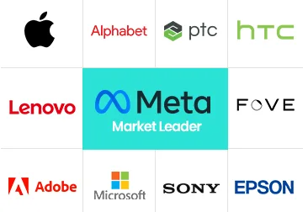
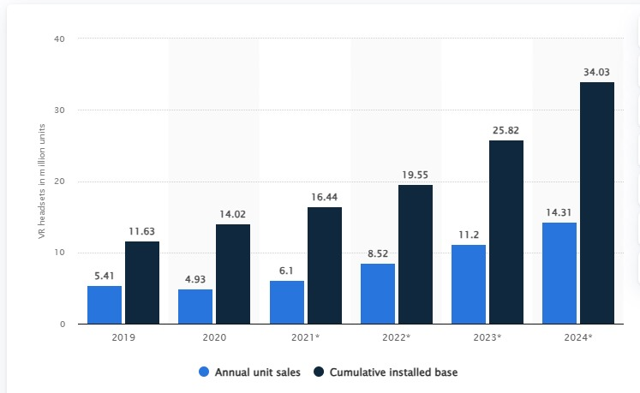
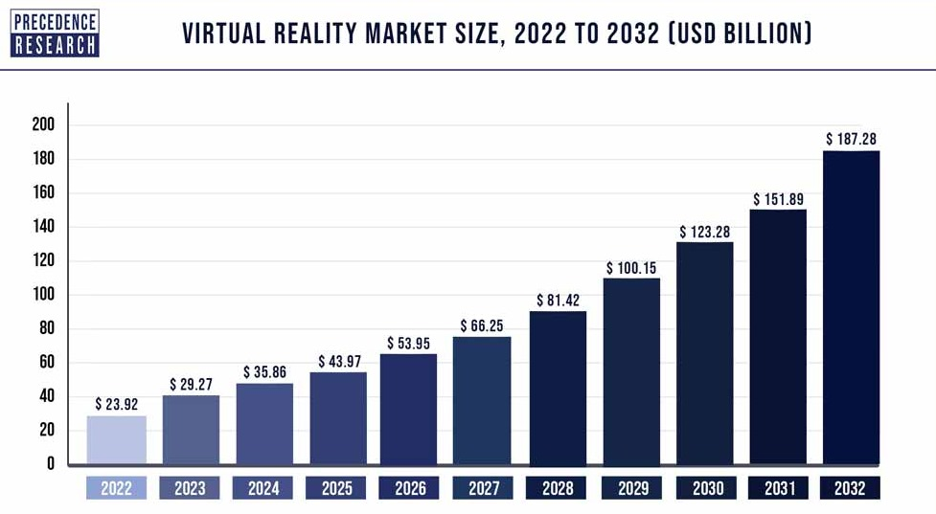
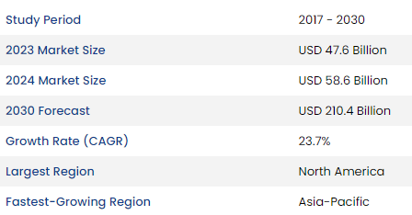
Current market and Expected growth

Slide 8
Products available in market
HaptX:
Product: HaptX Gloves
Features: Precise motion tracking, realistic haptic feedback, and force feedback for a highly immersive experience.
Manus VR:
Product: Manus Prime II
Features: Accurate finger tracking, wireless connectivity, and compatibility with various VR platforms.
SenseGlove:
Product: SenseGlove Nova
Features: Force feedback, motion tracking, and haptic feedback, designed for professional and industrial applications.
VRgluv:
Product: VRgluv
Features: Full hand and finger tracking, force feedback, and compatibility with major VR systems.
Neurodigital Technologies:
Product: Gloveone
Features: Haptic feedback, finger tracking, and lightweight design for comfortable use.

Slide 9
Major Market Contributors
Meta Platforms Inc. (formerly Facebook):
Market Cap: Approximately $805 billion (as of July 2023)
Key Products: Oculus VR headsets, AR glasses (Project Aria), Horizon Workrooms.
Sony Corporation:
Market Cap: Approximately $135 billion (as of July 2023)
Key Products: PlayStation VR.
Microsoft Corporation:
Market Cap: Approximately $2.5 trillion (as of July 2023)
Key Products: HoloLens AR headset, Mesh for Teams.
Apple Inc.:
Market Cap: Approximately $2.8 trillion (as of July 2023)
Key Products: Rumored AR glasses, ARKit for developers.
Google LLC (Alphabet Inc.):
Market Cap: Approximately $1.6 trillion (as of July 2023)
Key Products: Google Glass Enterprise Edition, ARCore for developers.

Slide 10
Effects on Different Sectors
Gaming and Entertainment: One of the most significant areas where AR and VR are used. Companies like Meta (formerly Facebook), Sony, and HTC are major players.
Healthcare: AR and VR are being used for surgical simulations, patient care management, and training. Companies like AccuVein and Medivis are key contributors.
Education and Training: These technologies are used for immersive learning experiences and vocational training. Companies like zSpace and Veative Labs are notable contributors.
Retail and E-commerce: AR is being used for virtual try-ons and enhancing shopping experiences. Companies like Shopify, IKEA, and Amazon are leading in this space.
Industrial and Manufacturing: VR and AR are used for design, prototyping, and training. Companies like PTC and Siemens are major contributors.

Slide 11
Usage
Gaming and Entertainment:
Enhanced Interactivity: VR gloves allow gamers to use natural hand gestures to control games, providing a more immersive experience than traditional controllers.
Realistic Feedback: Haptic feedback can simulate the feeling of touching objects within the virtual world, making the gaming experience more realistic.
Education and Training:
Skill Development: VR gloves are used in vocational training to teach skills that require precise hand movements, such as welding, painting, and assembly.
Interactive Learning: They enhance the learning experience by allowing students to interact with virtual objects and environments in a hands-on manner.

Slide 12
https://www.statista.com/outlook/amo/ar-vr/worldwide#analyst-opinion
https://www.psmarketresearch.com/market-analysis/augmented-reality-and-virtual-reality-market

